Slide 1
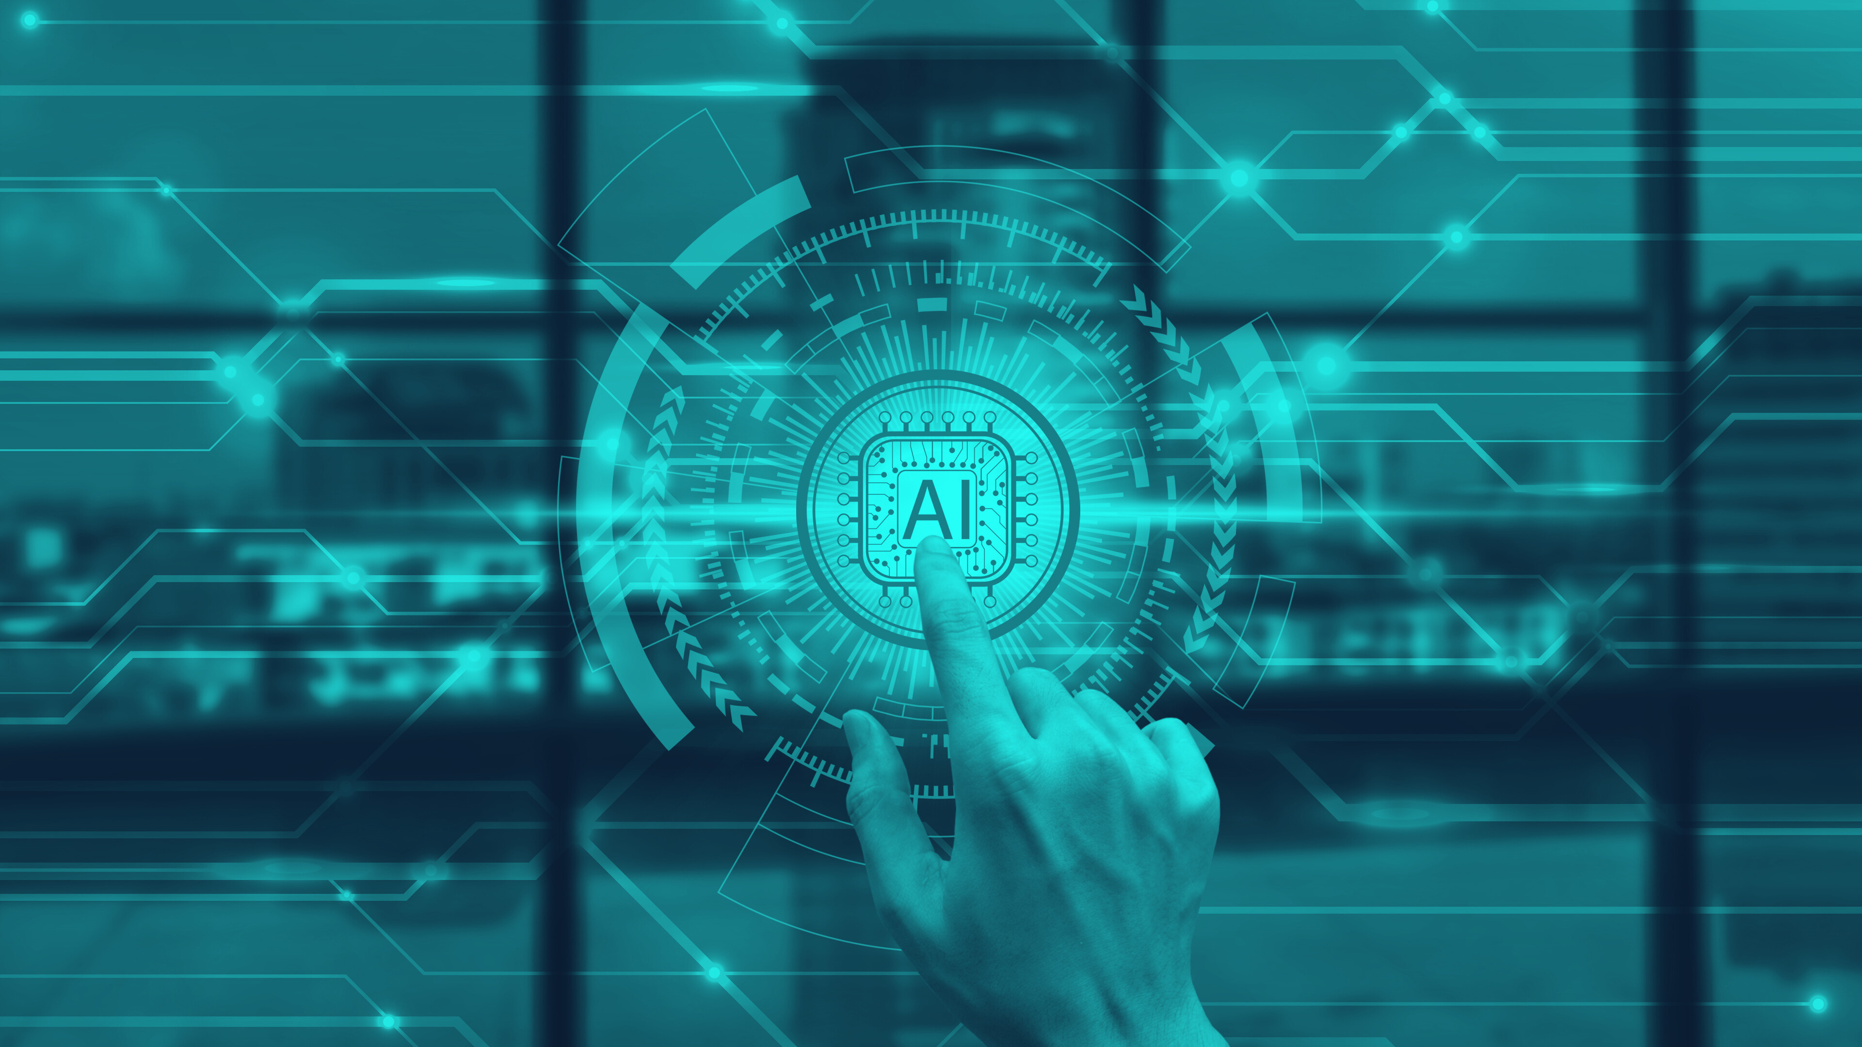
Model Context Protocol (MCP): Building Secure, Scalable AI Integrations
Presented By
Diptiman Mitra

Slide 2
Who Am I?
Diptiman Mitra – Lead Solutions Architect
15+ years in software development (full-stack engineer, architect)
Passionate about building secure, scalable systems
Outside work: Tech enthusiast, love teaching new skills to my son, trying to be a better trader

Slide 3
Agenda
What is MCP?
Why MCP and its evolution
MCP Architecture and Primitives
MCP Lifecycle Management / Message Flow Sequence
Deep dive: MCP Project
Demo
Code Walkthrough
Secure MCP
Q&A

Slide 4
What is MCP?
•Open-source protocol for connecting AI/LLMs to external tools & data
•Think of it as the 'USB-C of AI' – universal interface
•Replaces fragmented API integrations with a standard integration
LLM
MCP
Context
MCP is what makes AI actually useful for real apps
Notes:
Model Context Protocol (MCP) is an open protocol that enables seamless integration between LLM applications and external data sources and tools. Whether you’re building an AI-powered IDE, enhancing a chat interface, or creating custom AI workflows, MCP provides a standardized way to connect LLMs with the context they need.
"MCP is what makes AI actually useful for real apps" thats a big claim right. We will see if that's actually true.

Slide 5
Why MCP?
The M*N Integration Problem
LLM1
Resources
LLM2
Tools
LLM3
Prompts
Notes:
Agentic AI is revolutionary as part of Gen AI on top on LLMs that came into existence. Now think about a task you want to achieve as a part of agentic AI like read emails, parse the email or schedule in calendar or send emails based on incoming leads. You can have the agentic AI template developed but the integration that we would do LLM SDK differs from each provider. Example they way Open AI would communicate with these internal resources was different than how Anthropic would do. That caused a M*N integration problem.
This created lot of problem managing custom codes with each LLMs or even making changes to underline resources needed change in LLM.

Slide 6
Why MCP?
MCP Simplifies the Integration Problem for Agent Development
LLM1
Resources
LLM2
MCP
Tools
LLM3
Prompts
M+N Integration
Notes:
That's where MCP came as a standard protocol released in November 2024. So, not even a year old in it infancy stage to solve the M*N problem with M+N integrations. Irrespective of LLM provider MCP provided a standard protocol will that help this integration possible.
Even if the underlying assets changes or DB fields or mapping changes doesn't require LLM to change.

Slide 7


MCP Architecture
Host
Tools
Resources
Client
Server
Prompts
User
Client
Server
Client
Server
User: Human interacting with Claude desktop or chatbot or VSCode
Host: AI application (Claude, ChatGPT, IDEs) that orchestrates flow between user request, LLM, tools.
Client: Protocol handler, 1:1 connection per server, manages capabilities like discovery, invocation.
Server: Exposes data/tools in standardized format via MCP primitives
Notes:
User in this case can be a human interacting with a chatbot or claude desktop or VSCode.
Host application is the Claude desktop or cursor that orchestrates flow between user request, LLM, tools
Client are the protocol handler that maintain 1 to 1 connection per server and manages capabilities that are provided by MCP Servers like discovery, invocation. We will talk more on these.
Server is the MCP server we will be building today. Which acts as a proxy and enables access to underlying tools, resources and prompts to our LLMs. We will learn them in details.

Slide 8
MCP Primitives
•Tools → Executable functions (e.g., send email, internal resources, can perform read/write)
•Resources → Read-only data access (files, DB records)
•Prompts → Structured templates for workflows
Notes:
Tools are the internal resources like API, 3rd party APIs which LLM can use to perform both read and write operations. Think them as "hands" of your AI.
Resources are read-only data. It could be pieces of data that our system exposes it can be a file exposed via URI or a DB records. Think them as "eyes" that let AI see your data.
Prompts and Sampling are both executed in the server side. These are useful when your MCP Server has capabilities to run LLMs. Prompts are something that talks about "what to say". It will make the user task easier by guiding next. We are not going to cover prompts in our session. This will be some advanced topic to learn.
Sampling is server-initiated LLM requests. When your tools need to think for themselves. Example - Suppose you have a create user tool. Now your LLM can generate context for user to take action like if user wants to create a random user or any specific user characteristics.

Slide 9
MCP Communication Layers
Application Layer : Tools, Resources, Prompts, Sampling
Protocol Layer : JSON-RPC 2.0 messages
Transport Layer : stdio (local), streamable http (remote)
Notes:
Application layer are the four pillar or primitives that we learned.
Protocol layer : This is the protocol define the data exchange between client and server. It follows Json RPC 2.0 format.
Transport Layer : That defines where you want to deploy your MCP. If your MCP is running in your local then use stdio, if MCP is deployed remote like docker in ECS then use streamable http.
When MCP was release first came SSE was used but now it's deprecated due to it's limitations like connection over-head. I think with latest MCP release they still provide backward compatibility but if you are creating new MCP server don't use SSE.

Slide 10
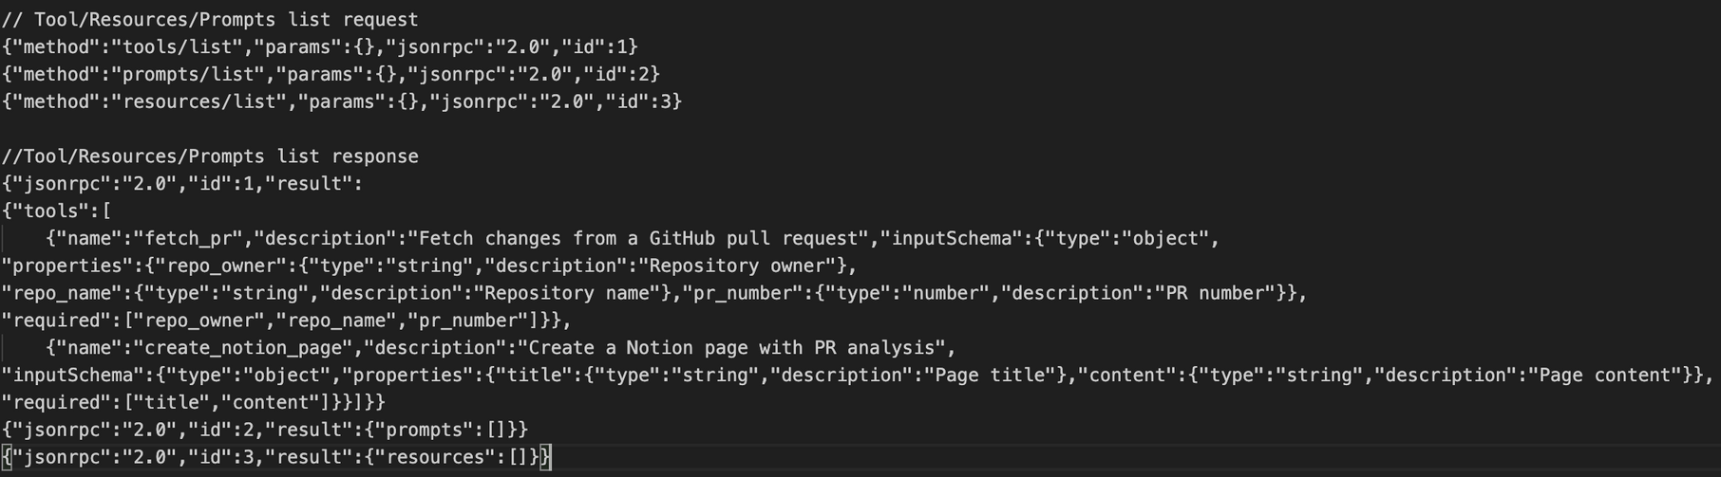
MCP Lifecycle Management / Message Flow Sequence
Initialization Phase: MCP begins with lifecycle management through a capability negotiation handshake.
2. Discovery Phase: Allows clients to understand what tools are available on the server before attempting to use them.
Notes:
MCP is a stateful protocol that requires lifecycle management. The purpose of lifecycle management is to negotiate the capabilities that both client and server support.
1. Initialization Phase:
Client sends the Initialization request with the protocol version it supports along with client info and other metadata.
Then, server responses with it's version capabilities and what metadata.
This prevents communication errors that could occur when different versions attempt to interact. If a mutually compatible version is not negotiated, the connection is terminated.
The capabilities object allows each party to declare what features they support.
The clientInfo and serverInfo objects provide identification and versioning information for debugging and compatibility purposes.
2. Discovery Phase -
Now that the connection is established, the client can discover available tools by sending a tools/list request.
This request is fundamental to MCP’s tool discovery mechanism — it allows clients to understand what tools are available on the server before attempting to use them.
How This Works in AI Applications
The AI application fetches available tools from all connected MCP servers and combines them into a unified tool registry that the language model can access. This allows the LLM to understand what actions it can perform and automatically generates the appropriate tool calls during conversations.

Slide 11
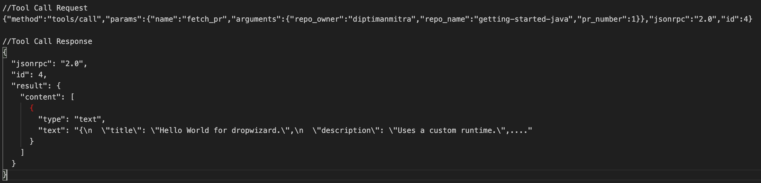
MCP Lifecycle Management / Message Flow Sequence
3. Execution Phase: The client can now execute a tool using the tools/call method.
Notes:
Execution Phase:
The client can invoke the tool that are discovered with proper arguments using the tools/call method.

Slide 12
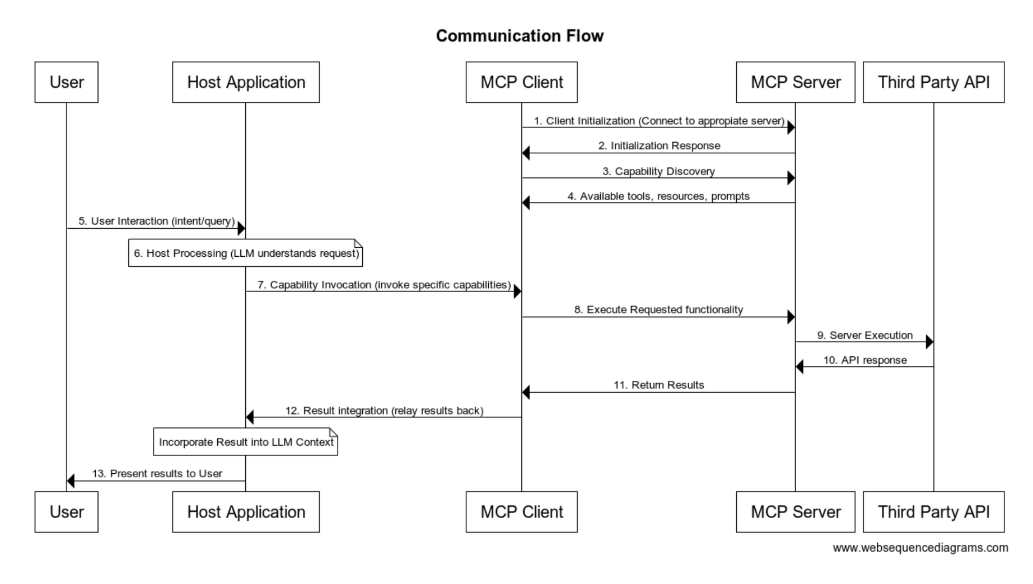

Slide 13
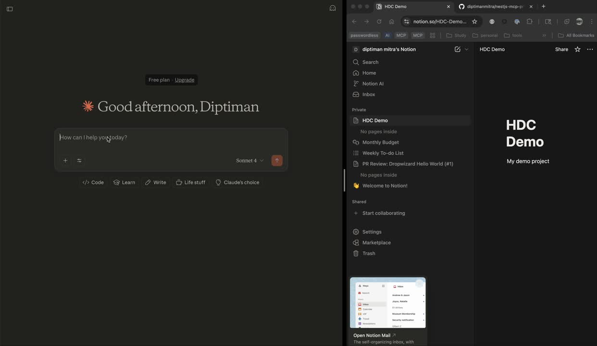
Demo

Slide 14
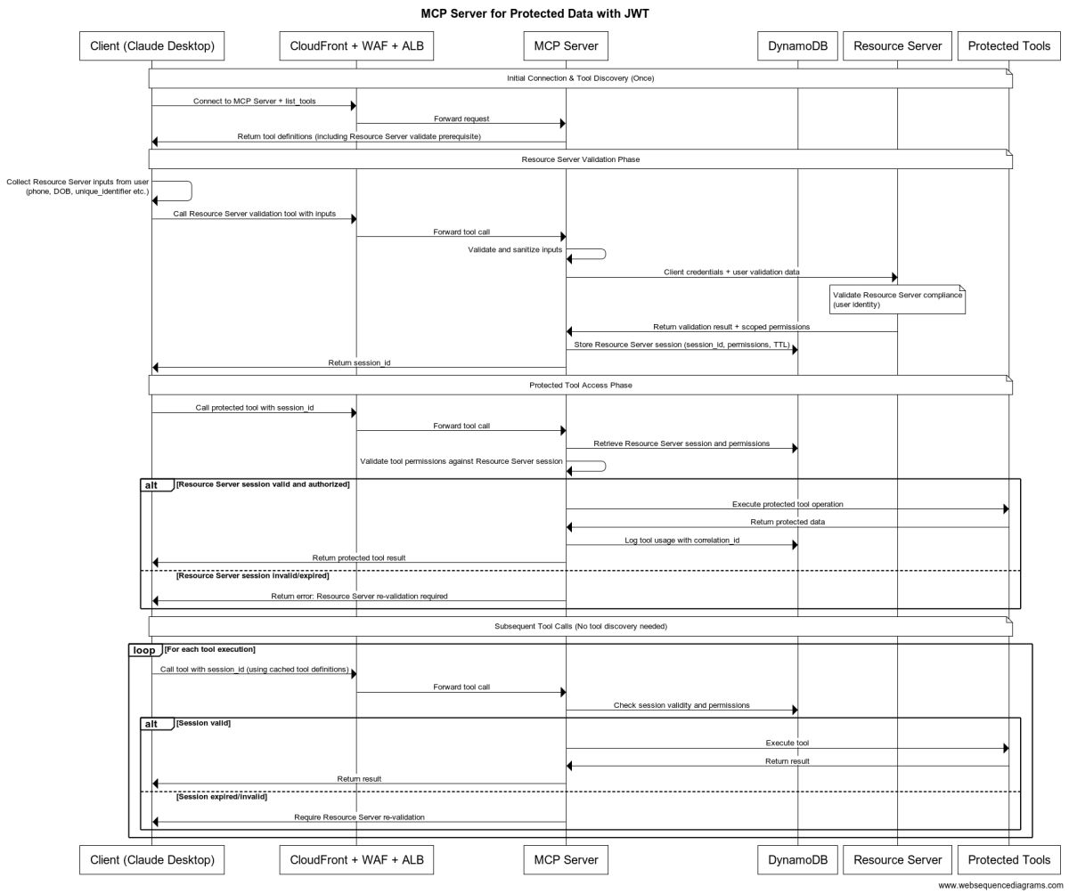
MCP Server for Protected Data with JWT

Slide 15
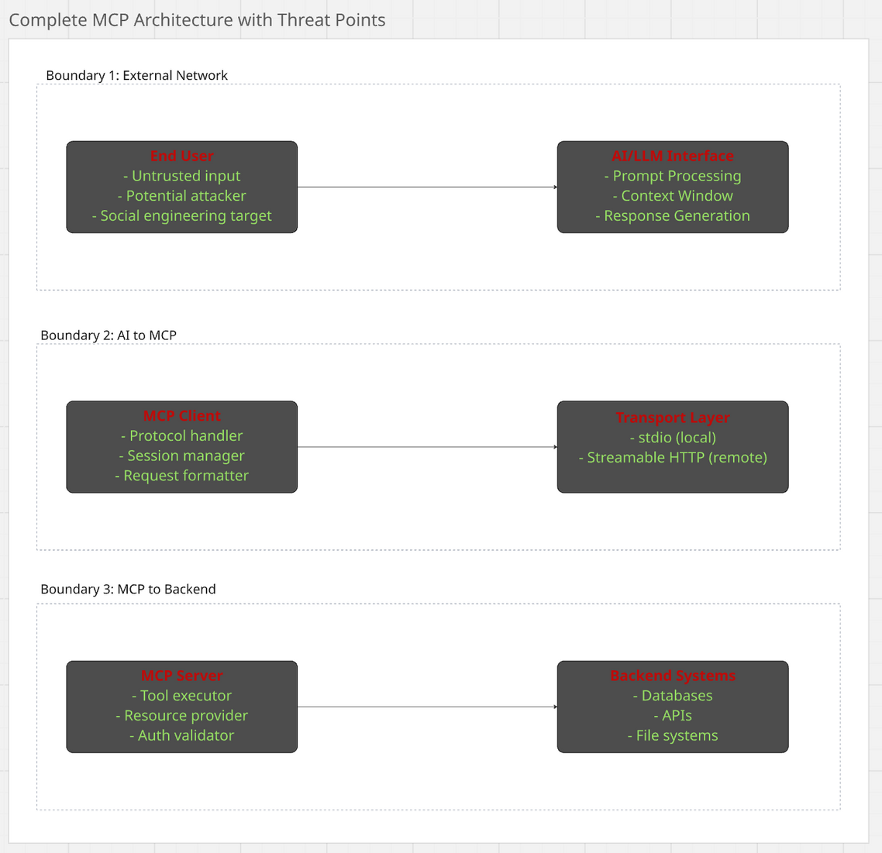
Complete MCP Architecture with Threat Points
Notes:
This Threat model can be distributed the boundaries into three layers.
1. First is the external boundaries End User - LLM
2. Second boundaries is AI to MCP i.e. MCP Client to transport Layer to MCP Server
3. Third layer is MCP Server to our systems i.e. API, Databases, 3rd party APIs.
This is end user interacting with LLMs. If we integrate our MCP server with VsCode, Cursor etc.
These are some threats that can happen.

Slide 16
Who’s using MCP ?
Company/Product | UseCase | Scale
Claude Desktop | IDE integration, File access | Millions of users
Cursor IDE | Code completion, Refactoring | 500K + Developers
Enterprise CRM | Customer Data access | 10K+ queries/day
Fintech Platforms | Transaction Processing | $1M+ daily volume
Healthcare AI | Medical Record analysis | 100K+ Records
UX design products (Figma) | Convert Figma design to code

Slide 17

GitHub link to the code and slides

Slide 18

Q&A
Connect me on LinkedIn

